Slide 1
Concurrency: Lock
Dr. Probir Roy
Some slides are modified from
* Dr. Shengquan Wang
Operating Systems: Three Easy Pieces, by Remzi H. Arpaci-Dusseau and Andrea C. Arpaci-Dusseau
Operating System Concepts, 8th edition, by Silberschatz, Galvin, Gagne, John Wiley & Sons, 2009

Slide 2
Key concurrency terms
Critical section is a segment of code, in which multiple threads may be changing shared variables (or more generally, a shared resource).
Such as “counter++” in previous example.
Multiple threads executing the critical section can result in a race condition.
Such as two threads’ executing “counter++”
Mutual exclusion: If one thread’s PC is already inside its critical section, the others will be prevented from entering theirs.
One kind of synchronization.

Slide 3
The crux: how to provide support for synchronization
What support do we need to get the desired results
from the hardware in order to build useful synchronization primitives?
from the OS?
How can we build these primitives correctly and efficiently?

Slide 4
Implementation
…
entry section;
critical section;
exit section;
…
…
entry section;
counter++;
exit section;
…

Slide 5
Outline
Basics

Slide 6
Locks
For instance, consider critical section
counter++;
Then use a lock:
lock_t mutex; // some globally-allocated lock
...
lock(&mutex);
counter++;
unlock(&mutex);

Slide 7

Mutex
lock(&mutex);
// critical section
unlock(&mutex);
A mutex variable acts like a "lock" protecting access to a shared data resource.
Source: Google Images

Slide 8
lock()
lock(&mutex);
// critical section
unlock(&mutex);
Calling the routine lock(&mutex) tries to acquire the lock mutex:
If no other thread holds the lock (i.e., it is free), the thread will acquire the lock (owner) and enter the critical section.
If another thread then calls lock(&mutex) on that same lock mutex, it will not return while the lock is held by another thread.

Slide 9
unlock()
lock(&mutex);
// critical section
unlock(&mutex);
Once the owner of the lock calls unlock(&mutex), the lock is now available again:
If no other threads are waiting for the lock, the state of the lock is simply changed to free.
If there are waiting threads (stuck in lock(&mutex)), one of them will eventually notice this change of the lock’s state, acquire the lock, and enter the critical section.

Slide 10
Example: Pthread locks
pthread_mutex_t mutex
pthread_mutex_init(mutex, attr)
attr, mutex object attributes (defaut: NULL).
pthread_mutex_destroy(mutex)
pthread_mutex_lock(mutex)
Attempts to lock a mutex;
The thread blocks if the mutex is already locked by another thread.
pthread_mutex_trylock(mutex)
Attempts to lock a mutex;
Return with a "busy" error code if the mutex is already locked
pthread_mutex_unlock(mutex);
Unlock a mutex if called by the owning thread.

Slide 11
Online tutorial
https://computing.llnl.gov/tutorials/pthreads

Slide 12
Example
pthread_mutex_t lock;
pthread_mutex_init(&lock, NULL);
…
pthread_mutex_lock(&lock);
counter++;
pthread_mutex_unlock(&lock);
Notes:
12

Slide 13
Corrected example “thread.c”
pthread_mutex_t lock;
void *worker(void *arg) {
int i;
for (i = 0; i < loops; i++) {
pthread_mutex_lock(&lock);
counter++;
pthread_mutex_unlock(&lock);
}
return NULL;
}

Slide 14
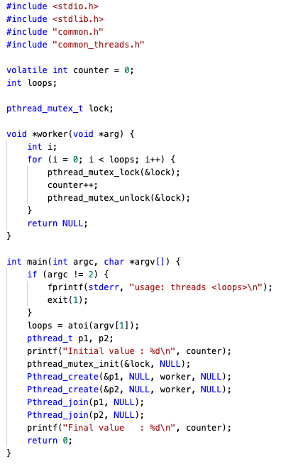
Corrected example “thread.c”

Slide 15
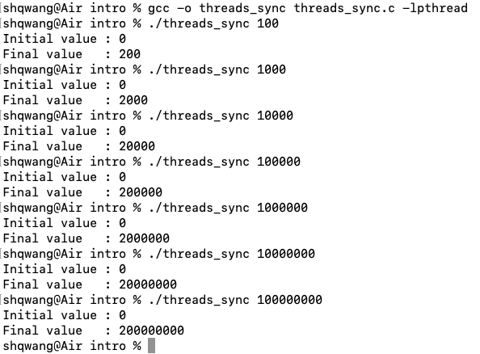
Demo

Slide 16
Another example: bank account
pthread_mutex_t lock;
pthread_mutex_init(&lock, NULL);
void withdraw(int amount) {
assert(amount < 0);
pthread_mutex_lock(&lock);
balance = balance + amount;
pthread_mutex_unlock(&lock);
}
void deposit(int amount) {
assert(amount < 0);
pthread_mutex_lock(&lock);
balance = balance - amount;
pthread_mutex_unlock(&lock);
}
Use one lock for two critical sections!

Slide 17
The crux: How to build a lock
How can we build an efficient lock?
What hardware support?
What OS support?

Slide 18
Evaluating locks
Mutual exclusion
Basically, does the lock work, preventing multiple threads from entering a critical section?
Fairness
Does each thread contending for the lock get a fair shot at acquiring it once it is free?
Does any thread contending for the lock starve while doing so, thus never obtaining it?
Performance
When a single thread is running and grabs and releases the lock, what is the overhead of doing so?
When multiple threads are contending for the lock on a single CPU, are there performance concerns?

Slide 19
Outline
Basics
Software solution

Slide 20
First attempt without hardware support
Use a simple variable to indicate whether some thread has possession of a lock.
typedef struct __lock_t {
int flag;
} lock_t;
void init(lock_t *lock) {
lock->flag = 0; // 0: unlocked, 1: locked
}

Slide 21
First attempt without hardware support (cont’d)
typedef struct __lock_t {
int flag;
} lock_t;
void init(lock_t *lock) {
lock->flag = 0; // 0: unlocked, 1: locked
}
void lock(lock_t *lock) {
while (lock->flag == 1) // TEST the flag
; // spin-wait (do nothing)
lock->flag = 1; // now SET it!
}
void unlock(lock_t *lock) {
lock->flag = 0;
}
lock_t lock;
init(&lock);
…
lock(&lock);
// … critical section
unlock(&lock);

Slide 22
Problem 1: interleaved operations
Thread 0
Thread 1
call lock() while (lock->flag == 1)
;
// flag==0: it is unlocked, continue
[interrupt, switch to thread 1]
lock->flag = 1; // lock it too!
call lock() while (lock->flag == 1)
;
// flag==0: continue
lock->flag = 1; // lock it
[interrupt, switch to thread 0]

Slide 23
Problem 2: spin waiting
typedef struct __lock_t {
int flag;
} lock_t;
void init(lock_t *lock) {
lock->flag = 0; // 0: unlocked, 1: locked
}
void lock(lock_t *lock) {
while (lock->flag == 1) // TEST the flag
; // spin-wait (do nothing)
lock->flag = 1; // now SET it!
}
void unlock(lock_t *lock) {
lock->flag = 0;
}
lock_t lock;
init(&lock);
…
lock(&lock);
// … critical section
unlock(&lock);

Slide 24
Solving spin-waiting: yielding
A simple approach: when you are going to spin, instead give up the CPU to another thread.
void lock(lock_t *lock) {
while (lock->flag == 1)
yield(); // give up the CPU
}
What happens?
OS switches the threads between running and ready/runnable states.

Slide 25
Problem with yielding under many threads
Consider 100 threads and a round-robin (RR) scheduler.
If one thread acquires the lock and is preempted (after a time quantum) before releasing it,
The other 99 will each call lock(), find the lock held, and yield the CPU.
The thread holding the lock gets to run again after each of the 99 executes this run-and-yield pattern.
It is still costly.

Slide 26
Solving spin-waiting: sleeping
When a thread calls lock, the thread will be put into a queue to sleep.
The sleeping thread is in blocked/waiting state, not in ready state or running state.
The sleeping thread will not compete for CPU in sleep.
When a thread calls unlock, some thread in the queue will be waken up.
Issue: which thread should be waken up?

Slide 27
Remarks on software solution
For some reason, developing locks that work without special hardware support was interesting and challenging.
Of course, this all became quite useless when people realized it is much easier to assume a little hardware support.
Notes:
27

Slide 28
Outline
Basics
Software solution
Hardware solution

Slide 29
Controlling interrupts
One of the earliest solutions used to provide mutual exclusion was to disable interrupts for critical sections.
This solution was invented for single-processor systems.
void lock() {
disable_interrupts();
}
void unlock() {
enable_interrupts();
}

Slide 30
Features
Pros:
Simplicity.
Cons:
It requires to allow any calling thread to perform a privileged operation (turning interrupts on and off), and thus trust that this facility is not abused.
Inefficient: code that masks or unmasks interrupts tends to be executed slowly by modern CPUs.
It does not work on multiprocessors.

Slide 31
Another hardware primitive: TestAndSet()
int TestAndSet(int *ptr, int new) {
int old = *ptr; // fetch old value at ptr
*ptr = new; // store ’new’ into ptr
return old; // return the old value
}
Atomic Exchange
TestAndSet enables us to “test” the old value (which is what is returned) while simultaneously “setting” the memory location to a new value.

Slide 32
Using TestAndSet
typedef struct __lock_t {
int flag;
} lock_t;
void init(lock_t *lock) {
lock->flag = 0; // 0: unlocked, 1: locked
}
void lock(lock_t *lock) {
while (lock->flag == 1) // TEST the flag
; // spin-wait (do nothing)
lock->flag = 1; // now SET it!
}
void unlock(lock_t *lock) {
lock->flag = 0;
}
lock_t lock;
init(&lock);
…
lock(&lock);
// … critical section
unlock(&lock);
void lock(lock_t *lock) {
while (TestAndSet(&lock->flag, 1) == 1)
;
}

Slide 33
Examine interleaved operations
Thread 0
Thread 1
call lock() while(TestAndSet(&lock->flag, 1) == 1)
;
// flag==0: continue
// lock->flag = 1;
……
call unlock()
lock->flag = 0;
call lock() while(TestAndSet(&lock->flag, 1) == 1)
;
// flag==1: wait
lock->flag = 1;
……
call unlock()
lock->flag = 0
No interleaved operations!

Slide 34
xv6 locking

Slide 35
xv6 locking (cont’d)

Slide 36
xv6 locking (cont’d)
xchg %eax, (addr): on x86, in one atomic operation, it swaps a word in memory with the contents of a register:
freeze other CPUs' memory activity for address addr
temp := *addr
*addr := %eax
%eax = temp
un-freeze other memory activity
The CPUs and memory system cooperate to ensure that “freeze” and “un-freeze”.
int xchg(addr, value) {
%eax = value
xchg %eax, (addr)
}

